Slide 1

IFHA Promotion and Media (IPM) Project
Promotor:
IFHA Deputy Secretary General Office
Marc Twagirumukiza
Supported by ISH Low & Middle Income countries Committee grant

Slide 2
IFHA Running Projects
      VITARAA
      NOAAH
      IPM
      ISH-LMICC Teaching seminar
      FAHS

Slide 3

Rationale
IFHA and African local hypertension societies organize bi-annual conferences, now for the 3rd time- totalizing more than 45original research presentations, but most of them never published in peer-review journals;
Until then, temporally websites for IFHA were created to support and to advertise the conference, no sustainable and permanent website.
IFHA Partners were few, since IFHA was not visible on worldwide market and IFHA was then less competitive compared to other organizations.

Slide 4

Rationale cont’d
Funding were lacking and every conference were initially funded by the board members (mainly executive president) in term to be reimbursed later on; what was not very often possible, because promises of funds were not given.
Mandatory it’s high time to set up a promotion measures making IFHA visible in worldwide scientific media sources and a sustainable way to keep partners and raising funds, not only for organizing conferences but also to support other activities.
Reliable data about hypertension patterns in Africa are lacking in many places, but rich data exist, hence it’s high time to put in press all existing data, or at least to indicate where to find them.

Slide 5

Objectives
To build up a promotion measures making IFHA visible in worldwide scientific media sources through a sustained and permanent professional website
To put in press all existing data, or at least to indicate where to find reliable data about hypertension patterns in Africa
To attract partners and to raise fund for supporting IFHA activities and to create a sustainable way of raising funds, not only for organizing conferences but also to support other IFHA activities.
To build up pathways for advertising IFHA and partners activities and updates
To create a virtual network inside physical IFHA & partners network linking worldwide stakeholders involved in hypertension research, control and prevention in Africa.

Slide 6

Preliminary achievements
Version 1.0 of the website ===> 25 july 2009
Version 2.0 of the website ===> 25 Sept 2009
   Supported by ISH Grant (Low and Middle income country committee – Professor Robert Fagard)
    -Webdesign
    -Webhosting & Domain names
   Implemented by Mr Steven Van Canneyt (Team Leader) of Department of Informatics of Gent University – Belgium, under a university contract arranged by Professor Luc Van Bortel

Slide 7
Costs rationalization
 Benefit: 85% saved on ordinary financial budget – Time :
  Ordinary total cost ( median price of the 3 pro-forma invoices received): 24 650$ US (Approx 19 000 €)
  Current cost: Work load (1800 € + 250 € taxes = 2050 €) + Domain name and hosting (295€ settled + 635 € /48 months to be paid = 930 €)
  ========➔ Total of 2980€

Slide 8

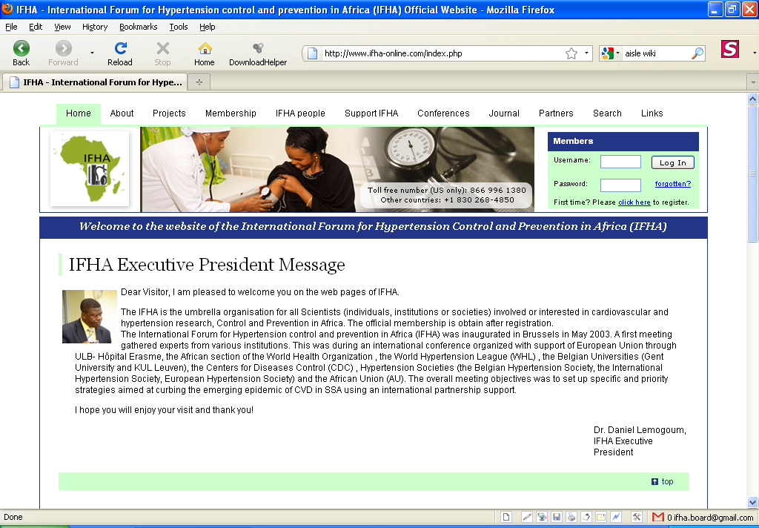
The website
http://www.ifha-online.org (.com, .net)

Slide 9

The website : main features
Dynamic website
  Every board member or a mandated member can update the web using dynamic links – even with zero-knowledge in webdesigning languange (HTML) or programing and with zero-risk for the stability of the website
Full information about IFHA and partners activities and updates
Triple portail : IFHA, Conferences and Teaching seminar
Possiblity to add specific pages for :
  IFHA Journal/Newsletter
  Projects specific pages
  Unlimitted subdomain
  Unlimitted e-mails, and much more….
eShop tool to disseminate all available data on hypertension from Africa
Tool free number & Google ad-words vouchers
Hosted in WORLDWIDE Top-ten hosting company – balancing quality & cost

Slide 10
Preliminary achievement cont’d
 Mid-time evaluation:
  So far received more than 2000 visitors from 67 countries world wide
  So far some payments (conference registrations or IFHA membership)have been done through online tool
  Abstract submission online tool tested with this conference

Slide 11
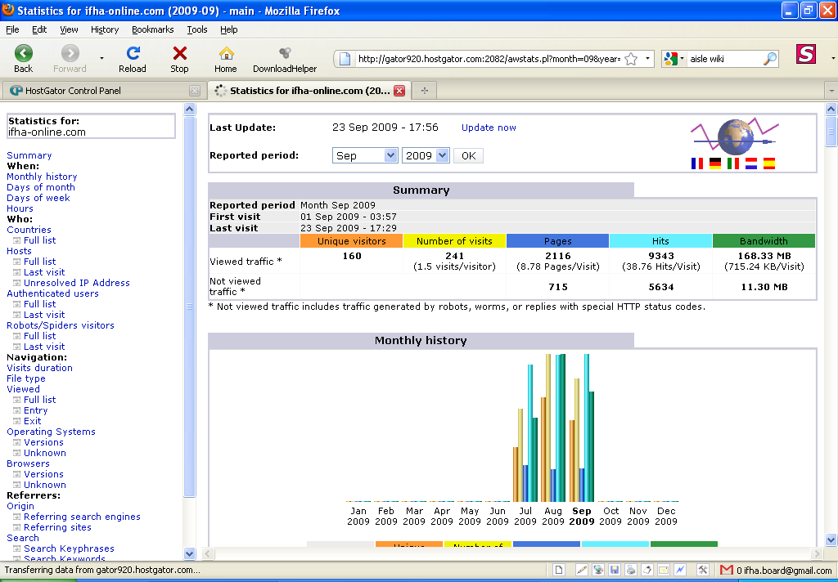
2116
160

Slide 12
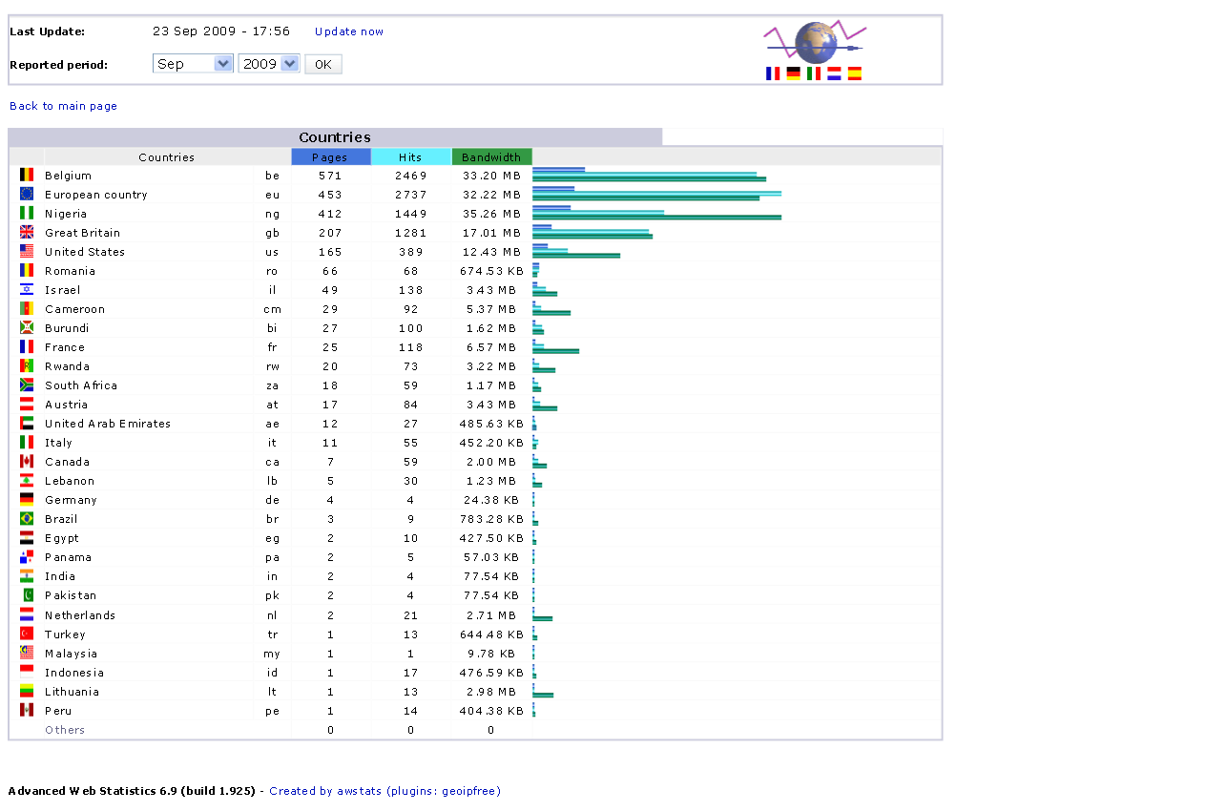

Slide 13
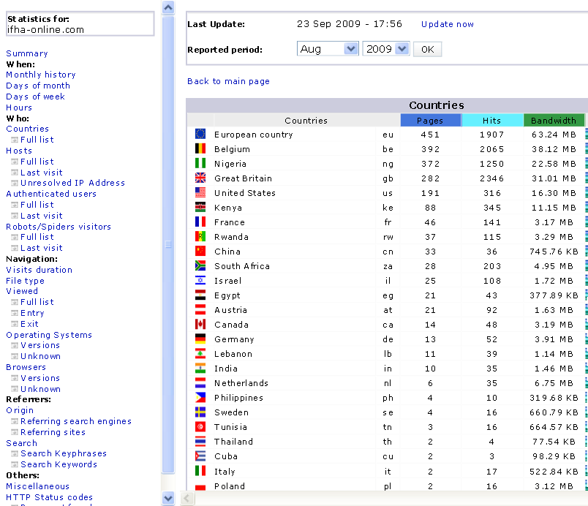

Slide 14
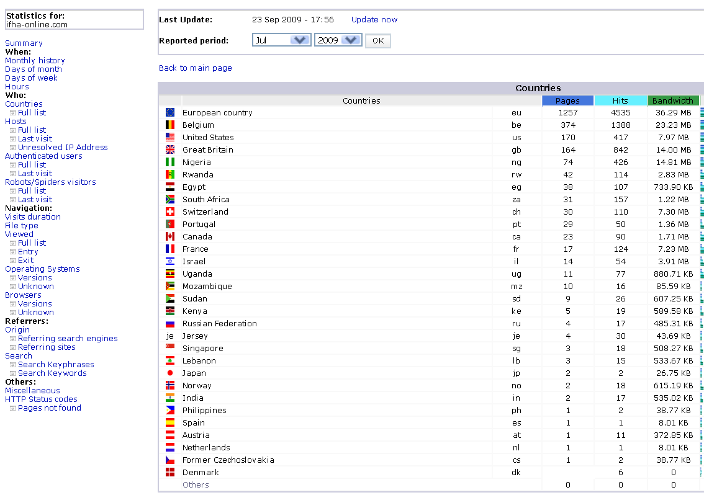

Slide 15
Next steps
  To complete some web pages (Journal/Newsletter, partners, etc)
  Website referencement
  Enhance eShop tool
  Promotion in Google using Google ads
  Attract advertisements form our partners
  Maintenance contract to be signed with the developper : 2hours every 6 months
  36 months period – evaluation

